Slide 1

Software Testing
Sana Rizwan
Assistant Professor
Department of Computer Science, CUI Lahore

Slide 2
Chapter 1 -- Introduction

Slide 3
What we need in life…
Life is nothing without software.
Appliances are shrinking to software systems. In automobiles, for example, microprocessors and their accompanying software control more and more functionality, from engine management to the transmission and brakes.
Software is crucial to the correct functioning of devices and industry.
The smooth operations depend upon the reliable, fast /quick new developments, update, extend, adjusted and adapt new changes in s/w.
That means quality of software is the major feature.
To improve software quality and engineering process, ways are systematic evaluation and testing of the software.

Slide 4
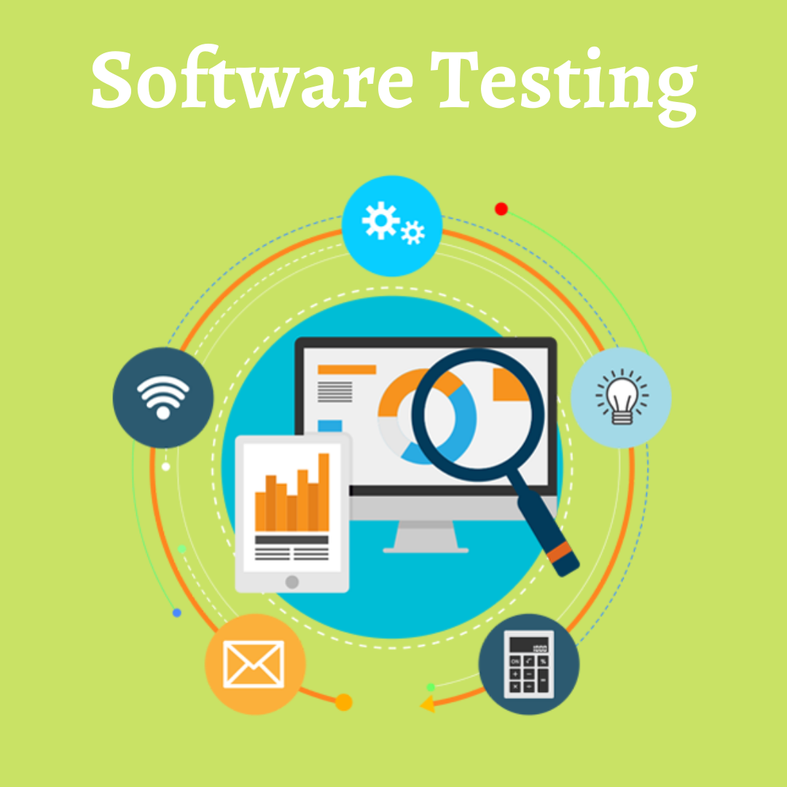
Why use software testing?
Software testing is a method of determining whether the actual software product meets the expected requirements and ensuring that the software product is free of defects.
It entails running software/system components through their paces using manual or automated tools to evaluate one or more properties of interest.

Slide 5



Goal of software testing
The goal of software testing is to find errors, gaps, or missing requirements in comparison to the actual requirements.

Slide 6

Benefits of software testing
Software testing is important because if there are any bugs or errors in the software, they can be identified early and fixed before the software product is delivered.
Properly tested software product ensures dependability, security, and high performance, which leads to time savings, cost effectiveness, and customer satisfaction.

Slide 7
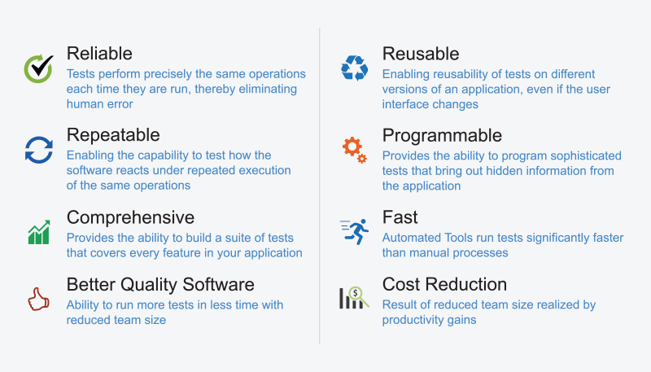
Benefits …

Slide 8
top reasons why the testing of the software is really important
1. Helps in saving money
The testing of software has a wide array of benefits. The cost-effectiveness of the project happens to be one of the top reasons why companies go for software testing Services.
The testing of software comprises of a bunch of projects. In case of any bug in the early phases, fixing them costs a reduced amount of money.
It is a prerequisite that should get the testing done in no time. Hiring quality analysts or testers who have an ample amount of experience and have gone through technical education for the projects, they are the investments and the project is going to reap the benefits.

Slide 9
top reasons why the testing of the software is really important
2. Security
It is another crucial point why software testing should not be taken into consideration.
The most vulnerable and sensitive part. There are a bunch of situations in which the information and details of the users are stolen and they are used for the benefits.
It is considered to be the reason why people look for the well tested and reliable products.
As a specific product undergoes testing, the user can be ensured that they are going to receive a reliable product. The personal details of the user can be safe. Users can receive products that are free from vulnerability with the aid of software testing.

Slide 10
top reasons why the testing of the software is really important
3.Quality of the product
For ensuring that the specific product comes to life, it should work in accordance with the following.
The needs of the product is a prerequisite as it is helpful in getting the prerequisite results.
Products should be serving the user in one way or the other. It is a must that it is going to bring the value, as per the promise.
It should function in a complete manner for ensuring an effective customer experience. It is also necessary to check the compatibility of the device.
For instance, in case, you are planning to launch an application, it is a must to check the compatibility of the same in a wide array of operating systems and devices.

Slide 11
top reasons why the testing of the software is really important
4. Satisfaction of the customer
The primary objective of the owner of the products is offering the best satisfaction of the customers. The reason is that it offers the prerequisite and perfect user experience.
Reap long-term benefits by opting for software testing. Earning the trust of the client is certainly not an easy task, primarily in case the product is found to be functioning and glitching every time or the other.
Used a lot of products and surely had several horrible experiences owing to which might have deleted the application.
The first impression is really important and if you fail to give the same, users are going to find another product which will accomplish all the requirements.

Slide 12
top reasons why the testing of the software is really important
5. Improving the development process
With the aid of Quality Assurance, find a wide array of scenarios and errors, for the reproduction of the error.
It is really simple and the developers need to fix the same in no time. In addition to this, software testers should be working with the development team parallelly, which is useful in the acceleration of the development procedure.

Slide 13
top reasons why the testing of the software is really important
6. Easy while adding new features
The more interconnected and older the code, the more difficult it is to change. Tests counteract this calcification tendency by allowing developers to confidently add new features. As a new developer, changing older parts of codebase can be terrifying, but with tests, at least know if broken anything important. This helps in making software stand ahead in the market, and beat the competition.

Slide 14
top reasons why the testing of the software is really important
7. Determining the performance of the software
Find software or application that has low or reduced performance, find that it brings your reputation down in the market.
Users are not going to trust any people. There are chances that the reputation of organization is going to suffer.
In accordance with the experts, it is not that important. However, in case, introduce any software in the market without software testing and after this, the performance of the software does not meet the expectation or requirements of the clients, convincing people will be a hassle.

Slide 15
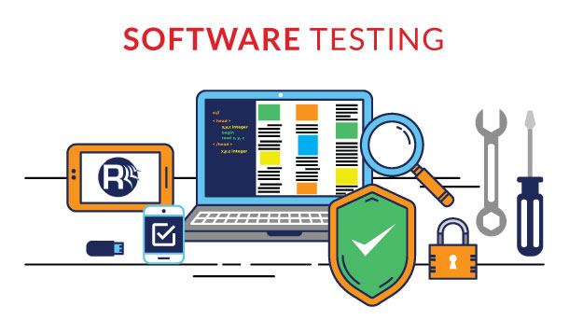
Any Questions

